Slide 1
Video 2: Corpus linguistic techniques
Maria Leedham
Full resource: https://www.ncrm.ac.uk/resources/online/all/?id=20855

Slide 2
Ways of analysing a corpus
Descriptive statistics on mean sentence length, variety of lexical items used, (per text and for the whole corpus)
Produce frequency word or phrase lists
Get concordance lines and sort these in different ways
Look at collocate lists for insight into the data
Find key words and phrases compared to a reference corpus
Look at plot dispersions to see how a linguistic feature is used across whole texts/the corpus
Search for similar lexical items/chunks through semantic or Part of Speech tagging
Notes:
Recap from video 1 – things you can do with a corpus

Slide 3
EXAMPLE CADS PROJECT A:
Student writing in different disciplines
Notes:
I’ll look at a variety of corpus tools to show what corpus linguistics can give you as a way in to exploring your data

Slide 4
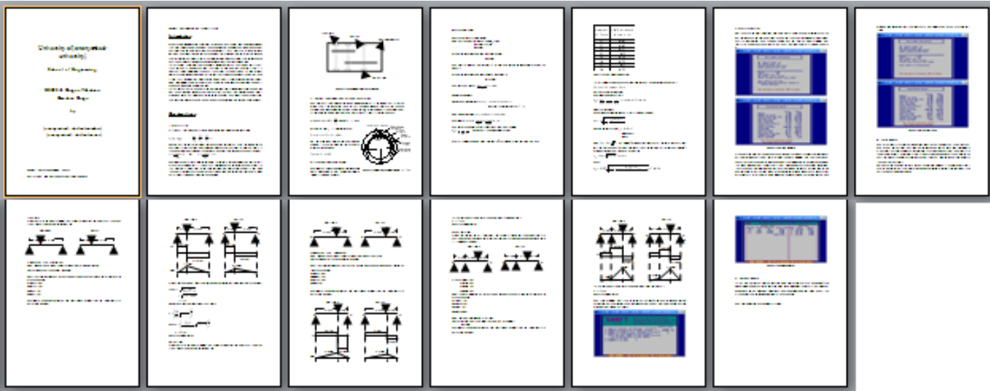
Student writing in different disciplines
Aims: To uncover similarities and differences in student writing across disciplinary areas and by students with different first languages
RQs
How does student writing differ in Engineering and Business Studies?
How does student writing differ across students with first language Chinese or first language English?
Notes:
Going to launch straight in to an example to show the value of a small corpus

Slide 5
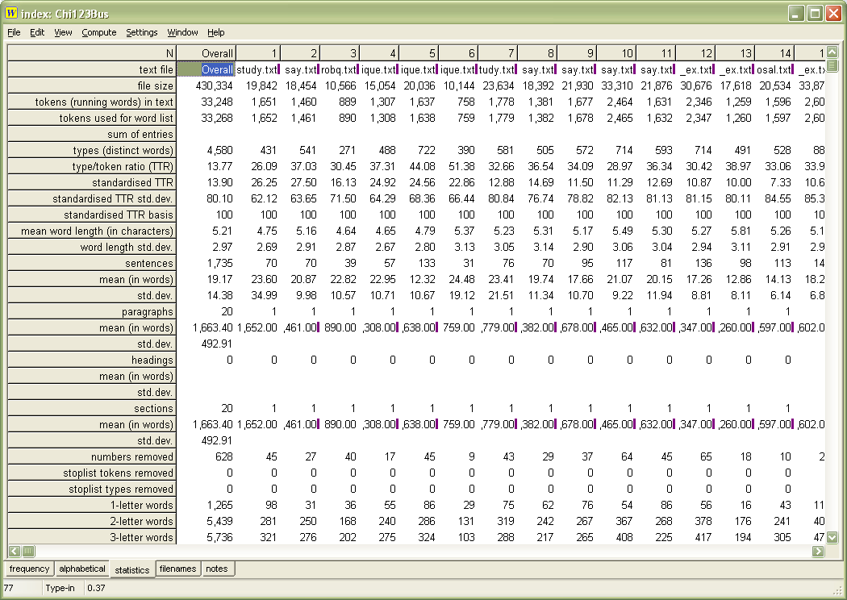
Descriptive statistics
Tokens
Types
STTR (Standardised Type Token Ratio)
Mean word/
sentence/paragraph lengths
Averages and per text
Notes:
The cat sat on the mat – 6 tokens, 5 types
Type token ratio as way in to looking at variety of lexis used. Does one corpus contain a wider variety of lexis than another?
Mean word or sentence length – a way in to looking at complexity of language – does one corpus use longer words or longer sentences or paragraphs than another?

Slide 6
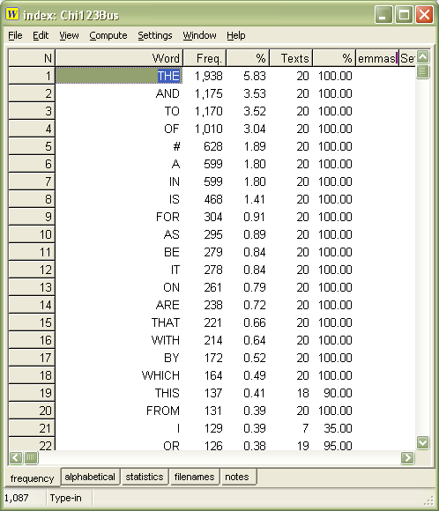
WordList
Top 20 words in written English (OEC)
1 the
2 be
3 to
4 of
5 and
6 a
7 in
8 that
9 have
10 I
11 it
12 for
13 not
14 on
15 with
16 he
17 as
18 you
19 do
20 at
TASK:
What are the top 10 words in written English, taken from web sources? (eg blog postings, internet sites).
Notes:
Ok, now we’re going to look at other projects I’ve worked on to illustrate different ways you might explore a corpus. Here’s a straightforward list of words, in order of frequency. Look at column headings in wordsmith tools
One difference is the hash sign appears in the Chinese list and not in the oxford English corpus. In wordsmith tools, the hash sign stands for any number. So this information provided a way in to exploring why Chinese students in my corpus might be using numbers far more often than in a general corpus. Also compared with a more similar corpus of L1 English students in same disciplines – need to compare like with like
The Oxford English corpus is one potential reference corpus. Another suitable reference corpus might be a corpus of assignments by students whose first language is English – think about year of study, discipline. Want to limit the variables so you know what you’re comparing.
Could compare two corpora with a third corpus to look for similarities.

Slide 7
Finding where words are in the text: eg a plot dispersion for 'I'
TASK: Why might some of these undergraduate assignments (from varied disciplines) have so many instances of ‘I’ at the END of the writing?
Clue: what might students be asked to do at the end of their assignment?

Slide 8
…When I began this ‘Self awareness’ module, I learnt I am psychologically and physically boundary less, but prefer to stay in the same organisation; also, I am self directed and actively manage my career in line with personal values which plays an important role of choosing employment.
7014a (Chinese year 3 Business narrative recount)
As I got into this piece of work, I enjoyed doing it more than I expected. There’s a great moment on each question where you press enter after putting in a lot of code or chasing a bug and it all just works.
6101l (English year 1 Computing exercise)

Slide 9
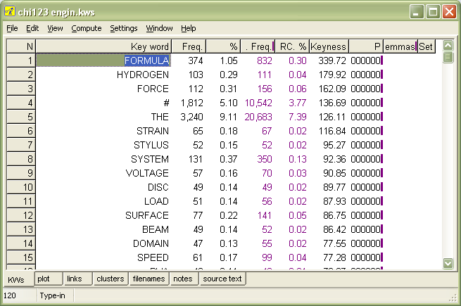
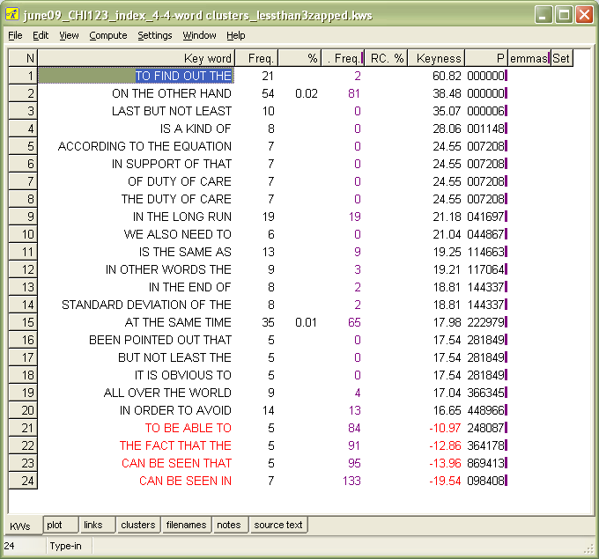
Key Words
and key clusters
“A word which is ‘key’ occurs more often than would be expected by chance in comparison with the reference corpus.” Mike Scott, 2008
Notes:
Using the same data set of student writing
KW - these indicate what is worth exploring further in our corpus through both corpus study (e.g. examining concordance lines/collocate lists) and qualitative study (reading the texts, using interview data, etc).
These words are key in Chinese engineering subcorpus compared to the English one. Most aren’t interesting as they simply indicate the topics that several students chose to cover. But here’s the hash sign again. So are Chinese engineering students using more numbers than L1 English students? Why? Worth investigating further
‘clusters’ are lexical chunks ie words that occur together. Here. I’ve pulled out 4-word chunks. Positively key and negatively key. So here we get some insight into the discourse markers and signposting used more often by the Chinese students than the British students. ‘according to the equation’ – do Chinese students use more equations or do they simply use this expression to refer to them? The corpus can’t tell us – need to read the texts.

Slide 10
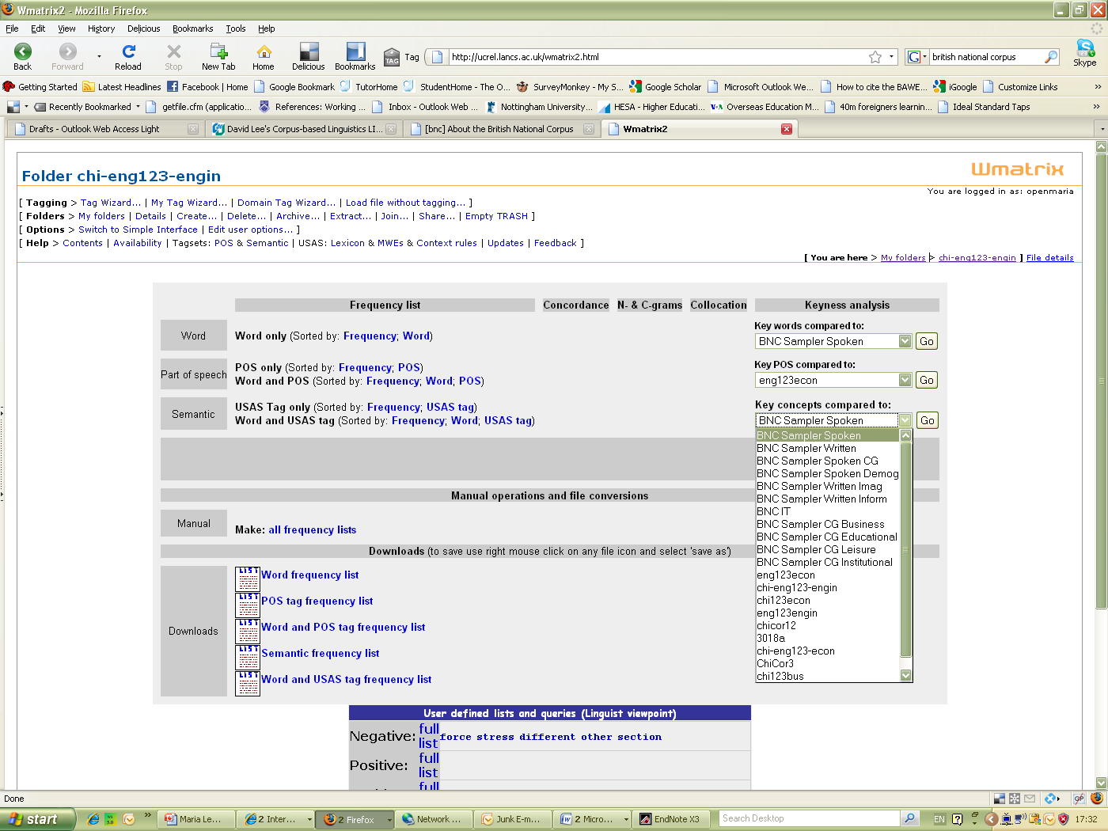
Exploring semantic tagging
Notes:
WMatrix to explore semantic areas. So the word ‘enormous’ might not occur enough to make it to a keylist. But if you explore the category of ‘large size’ then combined with big, huge etc it might appear.

Slide 11
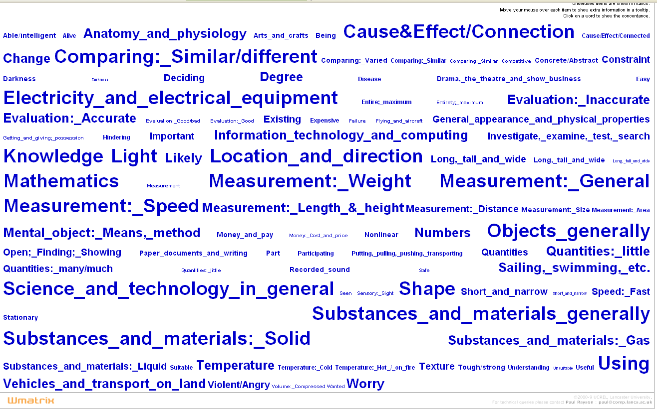
Semantic domains in Engineering
TASK: Is anything unexpected shown?
Notes:
Here are the key semantic domains in engineering when compared with all student writiing

Slide 12
Semantic domains in Engineering
TASK: Is anything unexpected shown?
Notes:
Appendix – it’s student writing!
Stress and Tension – technical terms!
Shows…. Got to eyeball your output. Explore the concordance lines and see what’s going on.
The semantic domains tell you something about engineering, providing another way of exploring the data. Could look at how change is discussed, how numbers are used, how cause and effect language is different from other disciplines
To conclude - Look through as many windows as possible into your data – corpus exploration could be one of these. and different techniques within this. trying to triangulate – find the same thing out each time – if not, why not. And explore new avenues to research.

Slide 13
www.ncrm.ac.uk

